Slide 1
Special Notes

Slide 2
Contents
Polyfills & Transpilers
Array & Object Destructuring
Object.keys().values().entries()
Bind(), Call(), Apply()
Error Handling try, catch()
instanceof

Slide 3
Transpilers
A special piece of software that translates source code to another source code. It can parse (“read and understand”) modern code and rewrite it using older syntax constructs, so that it’ll also work in outdated engines.
// before running the transpiler
JavaScript before year 2020 didn’t have the “nullish coalescing operator”, So it won’t work in outdated browser.
height = height ?? 100;
// after running the transpiler
A transpiler would analyze our code and rewrite
height = (height !== undefined && height !== null) ? height : 100;
Babel is one of the most prominent transpilers out there.
Webpack provide means to run transpiler automatically on every code change.

Slide 4
Polyfills
For new functions, not syntax changes, there’s no need to transpile anything here. We just need to declare the missing function.
In outdated browsers, there’s no Math.trunc, so code will get failed.
if (!Math.trunc) { // if no such function
// implement it
Math.trunc = function(number) {
// Math.ceil and Math.floor exist even in ancient JavaScript engines
// they are covered later in the tutorial
return number < 0 ? Math.ceil(number) : Math.floor(number);
};
}
Polyfill.io, core js are popular libraries of polyfills.

Slide 5
Array Destructuring
let arr = ['one', 'two', 'three’];
Before:
let a = arr[0];
let b = arr[1];
After:
let [a,b,c] = arr; console.log(a,b,c); // array destructuring
let [d, ,e] = arr; console.log(d,e); // skip inbetween items
let [f, ...g] = arr; console.log(f,g); //Assign Remaining Elements to a Single Variable
let [h,i,j,k='four']=arr; console.log(j,k); //default value provided
[user.name, user.surname] = "John Smith".split(' ‘); //also possible

Slide 6
Object Destructuring
let user = { fname:"john", lname:"britto" };
//before es6
let a = user.fname; let b = user.lname;
//after es6
let {fname,lname} = user; console.log(fname,lname);
let {fname:c,lname:d,e=100} = user; console.log(c,d,e); //own names & default values
let {...g} = user; console.log(g) // rest parameter

Slide 7
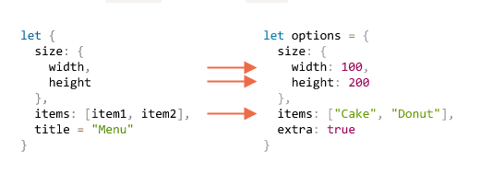
Nested Destructuring

Slide 8
Object.keys,values,entries
let salaries = {"John": 1000};
function sumSalaries(salaries) {
for (let values of Object.values(salaries)) { console.log(`values ${values}`); }
for (let keys of Object.keys(salaries)) { console.log(`key ${keys}`); }
for (let [keys,values] of Object.entries(salaries)) {
console.log(`key ${keys} & values ${values}`);
}
}
sumSalaries(salaries);
//key John
//values 1000
//key John & values 1000
Destructuring

Slide 9
Call, Bind and Apply in JavaScript
In other object-oriented programming languages, the this keyword always refers to the current instance of the class. Whereas in JavaScript, the value of this depends on how a function is called.
let person = {name:"john", print(){console.log(this.name)}};
person.print(); //function calling with person obj reference
// john
let name = person.print;
name(); // called without obj reference (global obj referred)
// undefined

Slide 10
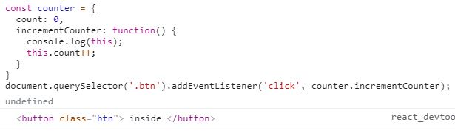
Issue : this in JavaScript
In below snippet, this keyword refers to the DOM element where the event happened, not the counter object. lost the reference for this.

Slide 11
Call( ), Bind( ), and Apply( ) to Rescue
Bind() : The bind method creates a new function and sets the this keyword to the specified object.
const john = {name: 'John'};
const jane = {name: 'Jane’};
function greeting() {console.log(this.name);}
const greetingJohn = greeting.bind(john); //creates a new function
greetingJohn(); //John
const greetingJane = greeting.bind(jane); //creates a new function
greetingJane(); // Jane
//bind method user here to refer this to john and jane object

Slide 12
Call( ), Bind( ), and Apply( ) to Rescue
Call() : sets the this keyword and executes the function immediately and it does not create a new copy of the function,
const john = {name: 'John'};
const jane = {name: 'Jane’};
function greeting(a,b) {console.log(this.name,a,b);}
greeting.call(john,”hi”,”en”); //parameters are comma separated
greeting.call(jane,”hello”,”ja”);

Slide 13
Call( ), Bind( ), and Apply( ) to Rescue
Apply() : method is similar to call(), The difference is that the apply() method accepts an array of arguments instead of comma separated values.
const john = {name: 'John'};
const jane = {name: 'Jane’};
function greeting(a, b) {console.log(this.name, a, b);}
greeting.apply(john, [“hi”, “en”]); //John hi en
greeting.apply(jane, [“hi”, “en”]); //Jane hi en
//parameters are array aruguments

Slide 14
Error handling, "try...catch"
handle runtime errors.
Error object contains :
name: the string with error name.
message: the human-readable error message.
stack: the stack at the moment of error creation.
we can omit it by using catch { instead of catch (err) {.
Technically, the argument of throw can be anything, but usually it’s an error object inheriting from the built-in Error class.
Error, SyntaxError, ReferenceError, TypeError etc.. are available errors. Eg. throw new Error()
window.onerror = function(message, url, line, col, error) { };

Slide 15
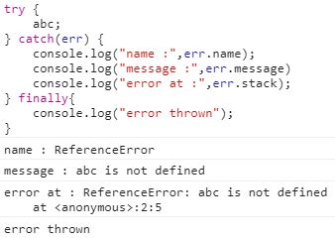
Error Object

Slide 16
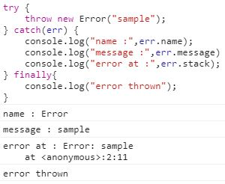
throw

Slide 17
instanceof
The instanceof operator allows to check whether an object belongs to a certain class.
class Rabbit {}
let rabbit = new Rabbit();
// is it an object of Rabbit class?
alert( rabbit instanceof Rabbit ); // true
class Animal {}
class Rabbit extends Animal {}
let rabbit = new Rabbit();
alert(rabbit instanceof Animal); // true

Slide 18
Rest parameters
In old browsers, arguments were used instead of rest parameters.
function sumAll(...args) { // args is the name for the array
console.log(arguments);
let sum = 0;
for (let arg of args) sum += arg;
return sum;
}
alert( sumAll(1, 2) ); // 3
alert( sumAll(1, 2, 3) ); // 6
// [Arguments] { '0': 1, '1': 2 }[Arguments] { '0': 1, '1': 2, '2': 3 }

Slide 19
Spread syntax
let arr = [3, 5, 1]; alert( Math.max(...arr) ); // 5
(spread turns array into a list of arguments)
let str = "Hello"; alert( [...str] ); // H,e,l,l,o
let arr = [1, 2, 3]; let arrCopy = [...arr];
let obj = { a: 1, b: 2, c: 3 }; let objCopy = { ...obj };

